Slide 1
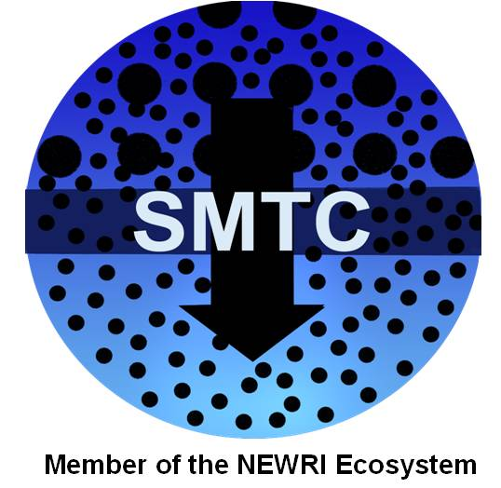

Silver Nanoparticle Impregnated Cryogels for Potable Water Production in Disaster-Relief Applications
William B. Krantz
Prof. Emeritus, Dept. of Chemical & Biological Engineering, U. of Colorado
Prof. Emeritus, Dept. of Chemical & Materials Engineering, U. of Cincinnati
Visiting Prof., Singapore Membrane Technology Center, Nanyang Technological U.
MEMSIS Inaugural Symposium
July 9, 2016

Slide 2

Food for Thought!
Maurits Escher’s Impossible Cube
Notes:
Let’s begin with some Food for Thought! One of my favorite artists is Maurits Escher. Escher was intrigued by ways to tile the plane with continuous figures.. My necktie shows an Escher print in which 3D boxes in the 2D plane evolve into birds. He was also fascinated by drawing figures in the 2-D plane that were impossible in 3D such as the Impossible Cube shown in this slide.

Slide 3
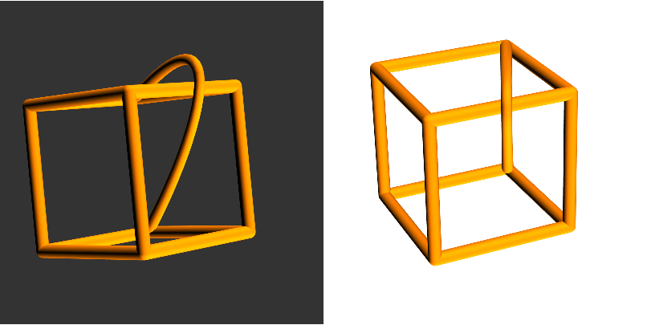
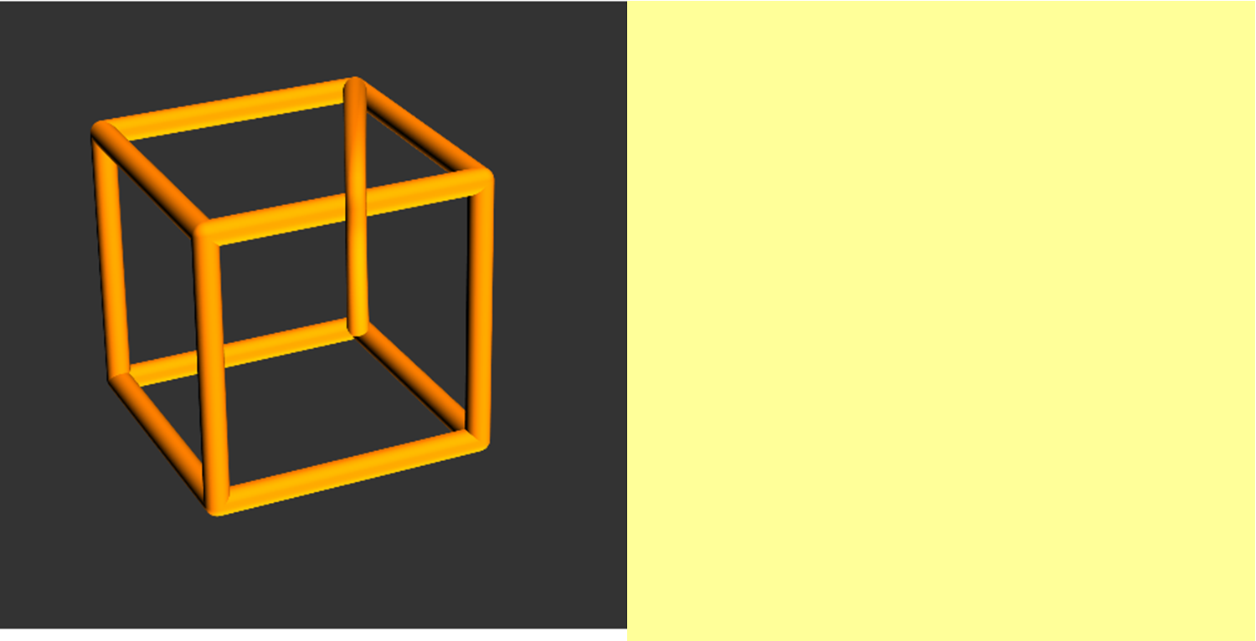
But is it?
– Thinking Outside the Box!
http://community.wolfram.com/groups/-/m/t/875044
Notes:
But is it impossible? If we “Think Outside the Box” we see that in fact the Impossible Box is Possible in 3D! This brings me to a message from our sponsors!

Slide 4
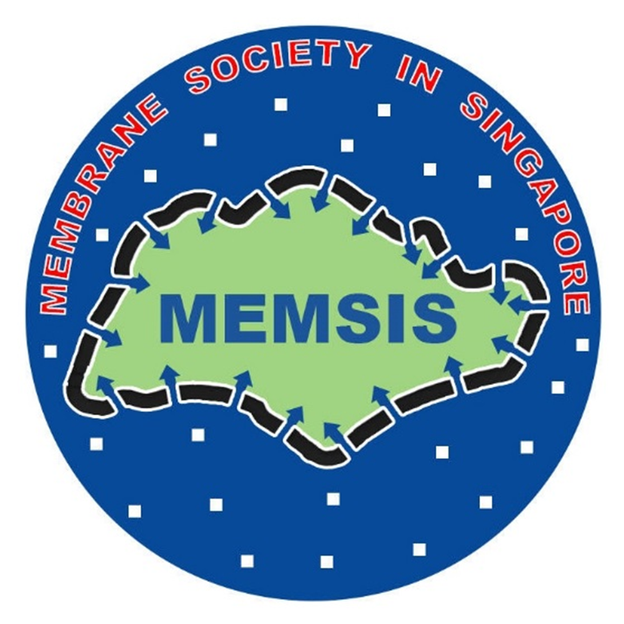
seminar
We interrupt this program for a message from our sponsors!

Slide 5

A Major Thrust of MEMSIS should be to Facilitate ‘Thinking Outside the Box’ to Advance Membrane Science and Technology in Singapore!
Notes:
We are gathered here today to inaugurate establishing the Membrane Society in Singapore. I do believe that a major thrust of MEMSIS is to facilitate ‘Thinking Outside the Box’ to advance membrane science and technology in Singapore!

Slide 6
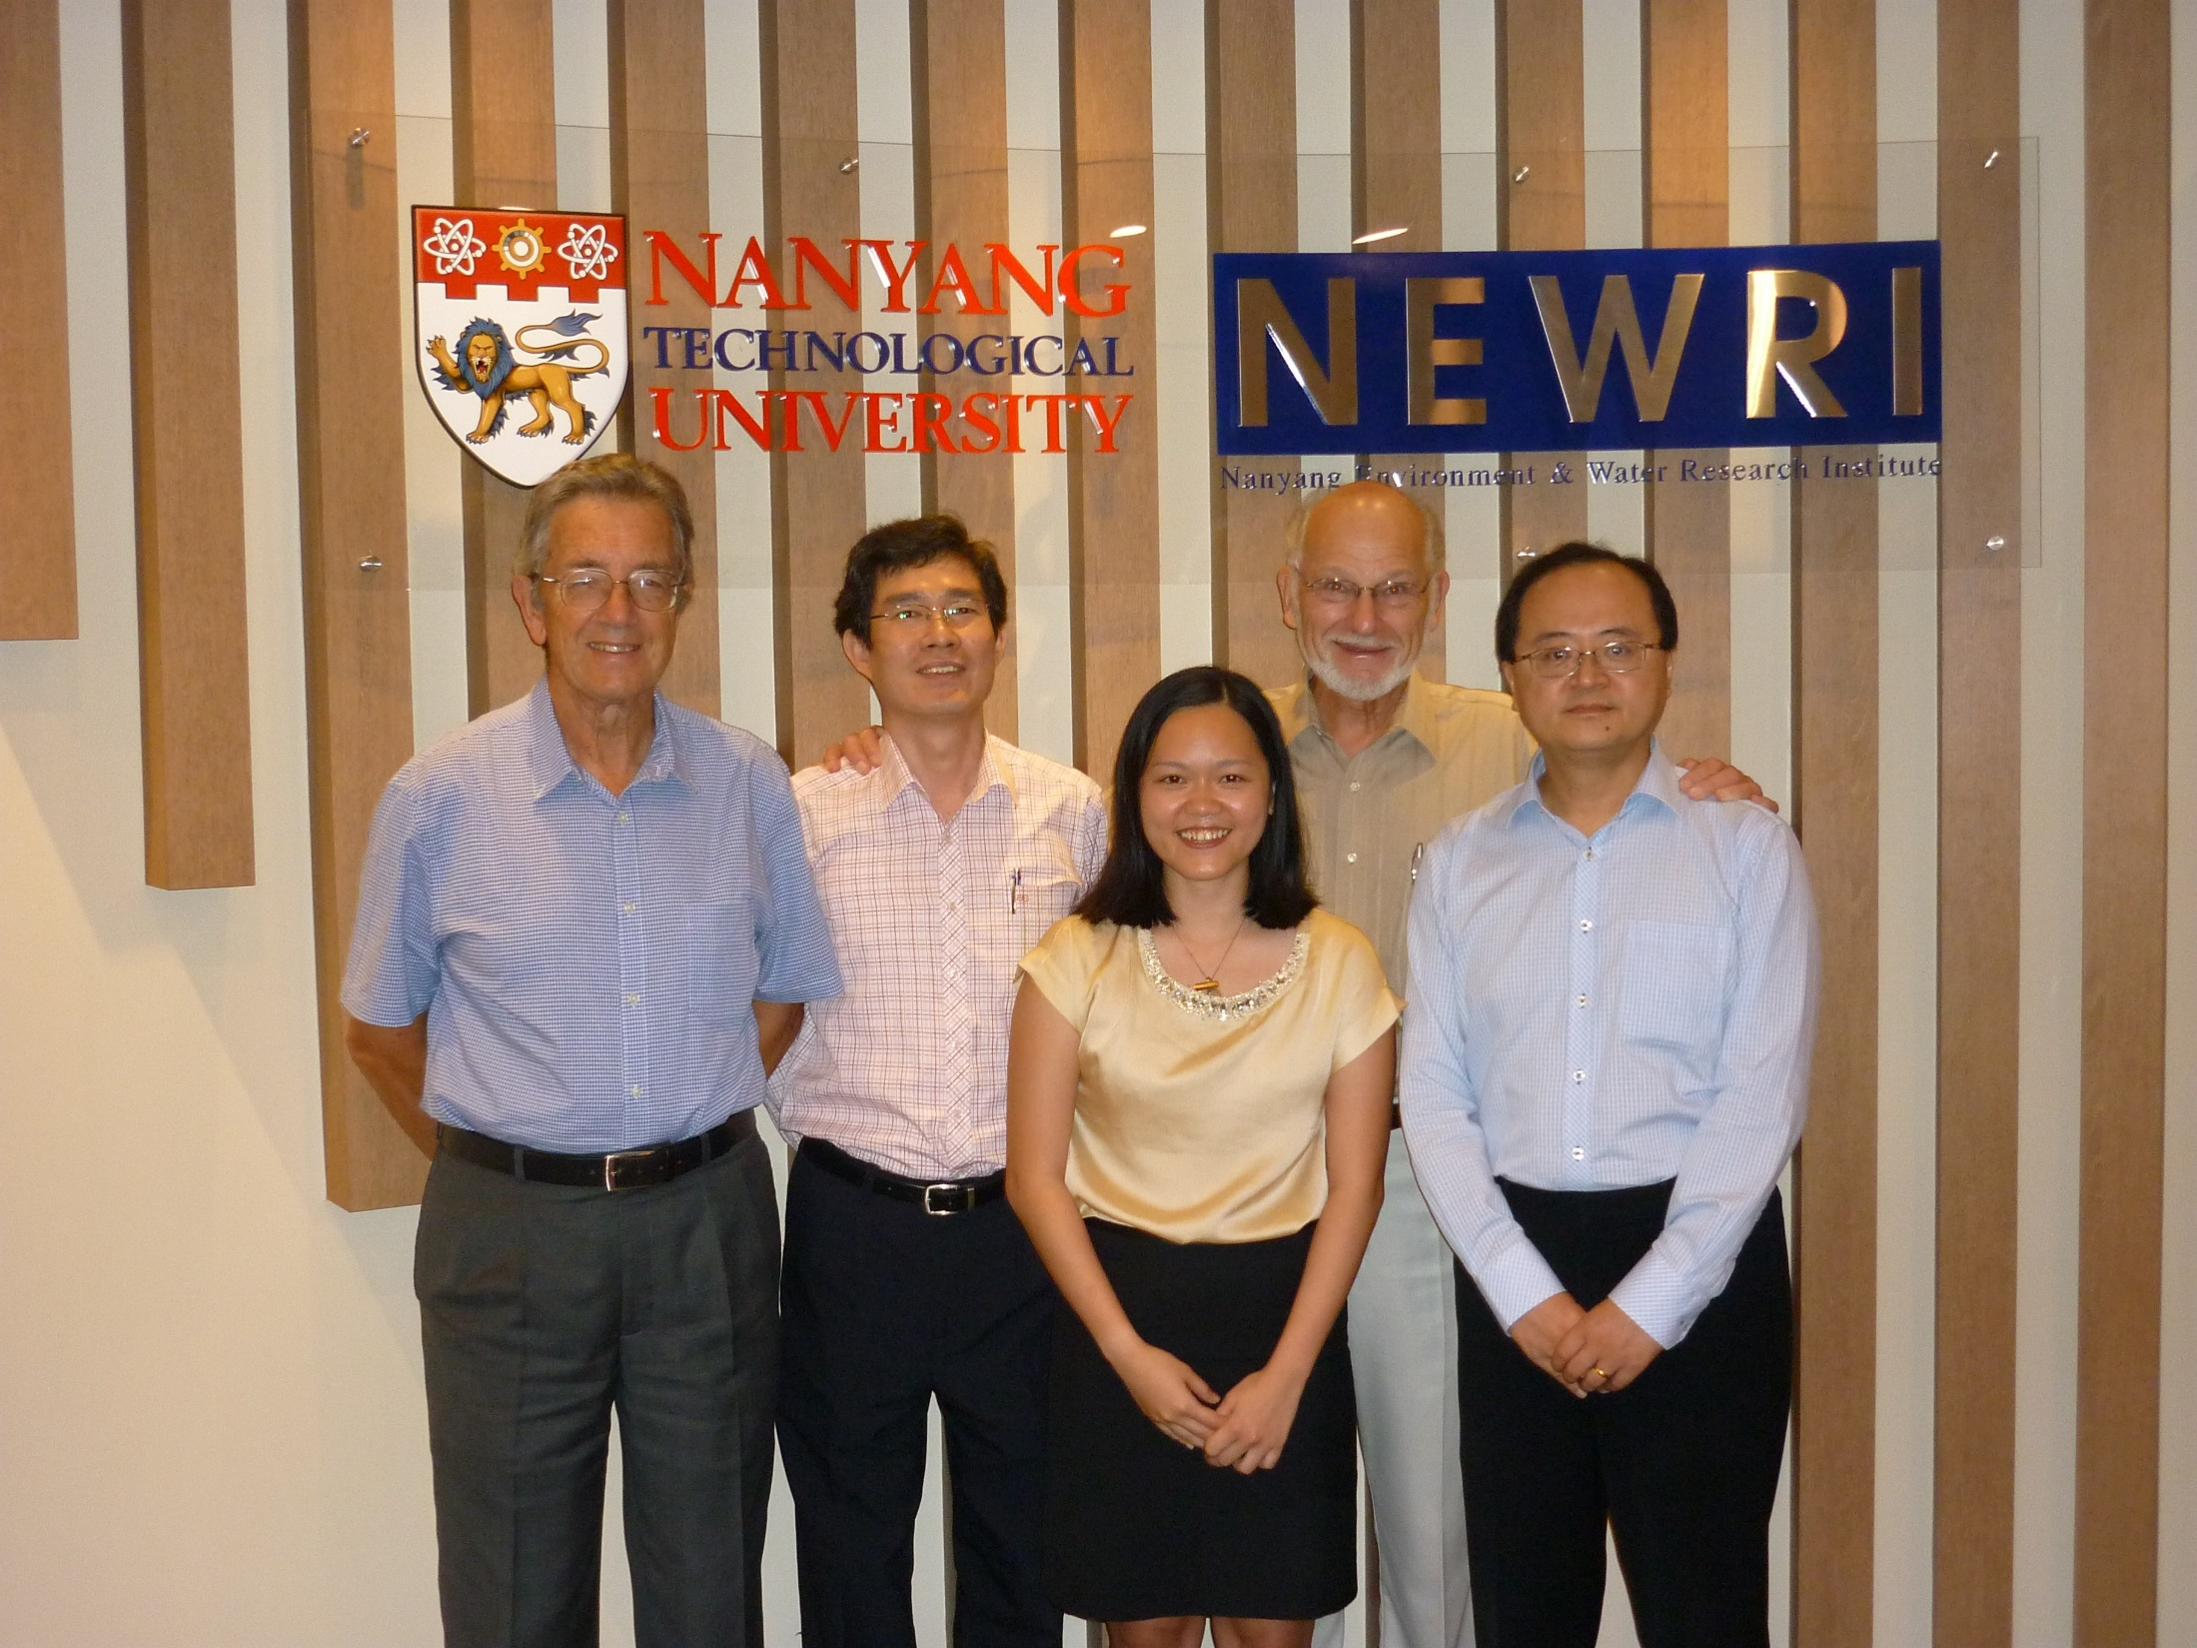

Slide 7
Patents and Papers
A.G. Fane, X. Hu, W.B. Krantz, T.T. Lim, S.L. Loo, Method of Disinfection of Drinking Water using Silver Nanoparticles Modified Cryogels, U.S. Provisional Patent Application No. 61/834,052, filed on June 12, 2013.
A.G. Fane, X. Hu, W.B. Krantz, T.T. Lim, S.L. Loo, Antibacterial Cryogels and Porous Hydrogels: their Preparation Method and their Use for Disinfecting Water, U.S. Provisional Patent Application No. PCT/SG2014/000273, filed on June 12, 2014.
S.-L. Loo, A.G. Fane, W.B. Krantz, T.-T. Lim, X. Hu, Emergency water supply: A review of potential technologies and selection criteria, Water Research 46 (2012) 3125-3146.
S.-L. Loo, W.B. Krantz, T.-T. Lim, A.G. Fane, X. Hu, Design and synthesis of ice-templated PSA cryogels for water purification: Towards tailored morphology and properties, Soft Matter 9 (2013) 224-234.
S.-L. Loo, A.G. Fane, T.-T. Lim, W.B. Krantz, Y.-N. Liang, X. Liu, X. Hu, Superabsorbent cryogels decorated with silver nanoparticles as a novel water technology for point-of-use disinfection, Environmental Science & Technology 47 (2013) 9363-9371.
S.-L. Loo, T.-T. Lim, W.B. Krantz, A.G. Fane, X. Hu, Potential evaluation and perspectives on using sponge-like superabsorbent cryogels for onsite water treatment in emergencies, Desalination and Water Treatment, 53(6) (2015) 1506-1515.
S.-L. Loo, W.B. Krantz, A.G. Fane, Y. Gao, T.-T. Lim, X. Hu., Bactericidal mechanisms revealed for rapid water disinfection by superabsorbent cryogels decorated with silver nanoparticles, Environmental Science and Technology 49 (2015) 2310-2318.
S.-L. Loo, W.B. Krantz, A.G. Fane, X. Hu, T.-T. Lim, Effect of synthesis routes on the properties and bactericidal activity of cryogels incorporated with silver nanoparticles, Journal of Materials Chemistry B 5(55) (2015) 44626-44635.
S.-L. Loo, W.B. Krantz, X. Hu, A.G. Fane, T.-T. Lim, Impact of solution chemistry on the properties and bactericidal activity of 2 silver nanoparticles decorated on superabsorbent cryogels, Journal of Colloid and Interface Science 461 (2016) 101-113.

Slide 8
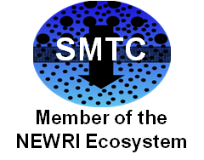
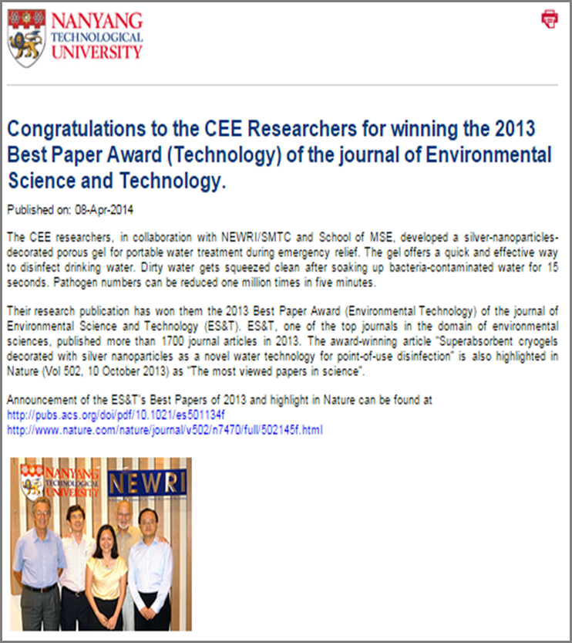
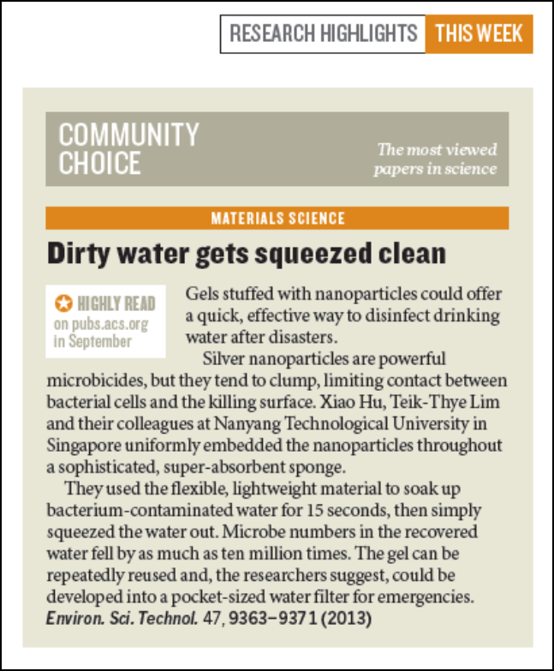
Recognition of this Research

Slide 9

Overview of Development of Novel Cryogels for Producing Potable Water
Need for this technology in disaster-relief applications
Requirements for this technology
Potential and limitations of hydrogels for providing potable water
Development of cryogels for this application
Sorption and mechanical properties of cryogels
Ability of cryogels to remove pathogens
Conclusions
Notes:
The development of the novel cryogels for providing potable water in disaster-relief applications was done by a young woman PhD student in the SMTC who very definitely did some’Thinking Outside the Box’!

Slide 10
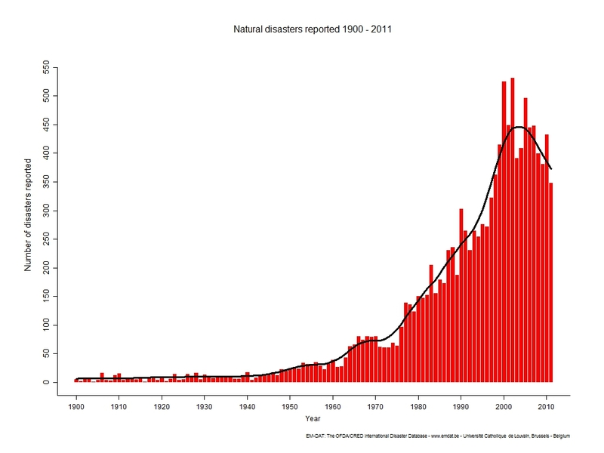
Motivation for Developing Novel Cryogels
Natural disasters reported 1900-2011
There has been a dramatic increase in global natural disasters
Number of Disasters Reported
Year
EM-DAT: The OFDA/CRED International Disaster Database

Slide 11
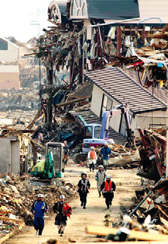
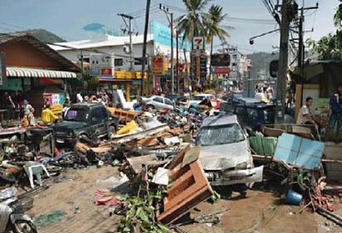
Aftermath of Recent Natural Disasters
2011 Japanese earthquake
Providing potable water in sufficient quantity is one of the first priorities in the aftermath of disasters
Challenging due to lack of infrastructure and resources
2004 Indian Ocean Tsunami

Slide 12
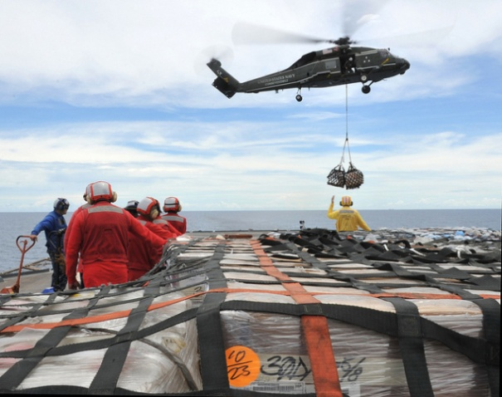
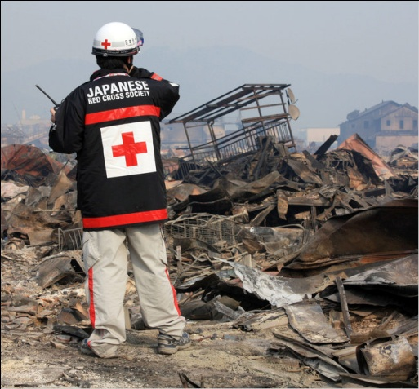
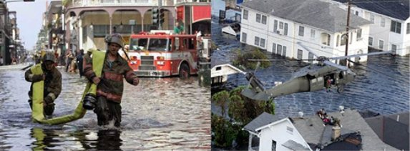
Requirements
Emergency water technologies should preferably be:
East to deploy
Simple to operate
Able to produce sufficient potable water
Operable by hand
Low cost

Slide 13
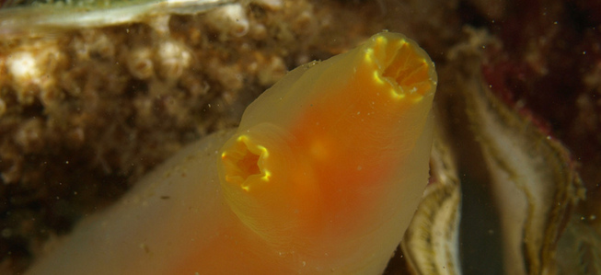
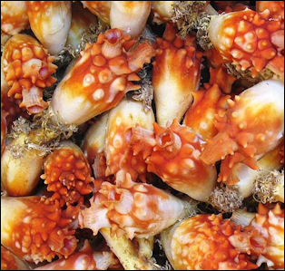
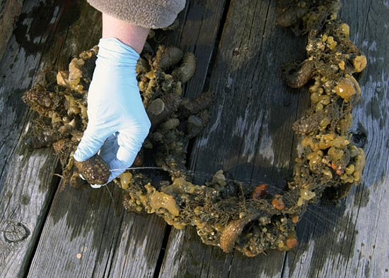
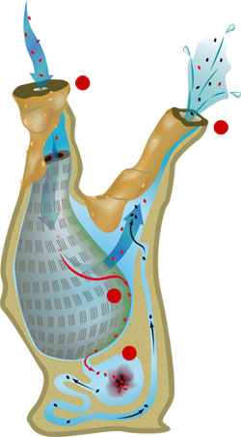
Inspiration from Nature to use Hydrogels for Water Purification
Sea Squirts
Sea squirts are filter feeders that spend most of their life span attached to rocks, coral reefs and wharf piles
They have two openings which are connected by a U-shaped tube. The entire structure is covered by jelly. Under water it is dilated and beautiful. When touched they shoot streams of water – a living water pistol
Notes:
LIVING WATER PISTOLS—As sea squirts feed on algae and bacteria, or when they are gently squeezed, they shoot water out of tiny pipes. These bursts of water give it the name “sea squirt.”
saclike body with openings through which water enters and leaves on contraction, eject a stream of water
"The sea squirt's body is made up of two cylinders. Water drawn into the main cylinder through the uppermost opening is filtered to extract food and oxygen, then escapes through the lateral cylinder. The small size of the lateral opening causes a rapid jet of water which carries the sea squirt's waste well beyond the incoming water current." (Foy and Oxford Scientific Films 1982:23)

Slide 14
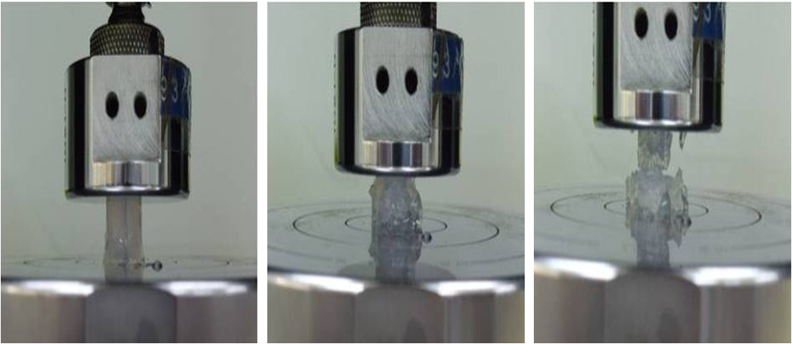
Background - Limitations of Conventional Hydrogels
Low swelling rate
  May take up to hours to reach equilibrium
  Slow because water absorption is limited by diffusion
Poor mechanical properties
  Low failure strains
Low efficiency of water recovery
  Only 5% recovery even under a pressure of 3 MPa of pressure
  Difficult because water is strongly bound to polymer
Cryogels can overcome these limitations!

Slide 15
Objectives of this Research
To prepare PSA/Ag cryogels having:
Fast and substantial swelling
High elasticity against compression
Good water recovery
Excellent antibacterial properties
Ability to maintain performance through multiple swelling/deswelling cycles
To study the feasibility of using PSA/Ag cryogels for point-of-use water disinfection

Slide 16
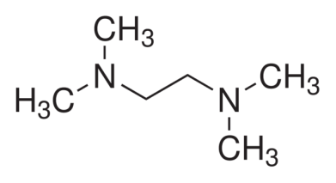

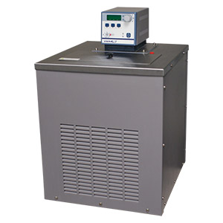
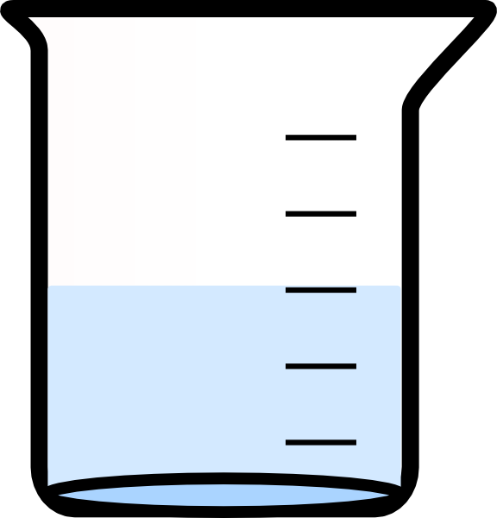
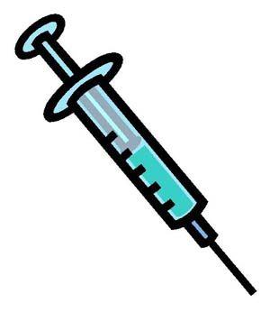
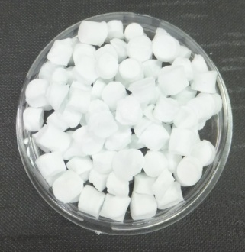
Synthesis of Microporous PSA (Poly Sodium Acrylate) Cryogels
Synthesis of PSA cryogels, [-CH₂-CH(COONa)-]_{n}
Monomer (SA)
sodium alginate
Crosslinker (MBA)
methylenebis(acrylamide)
Initiator (APS)
ammonium persulfate
Activator (TEMED)
tetramethylethylenediamine
APS + TEMED
Dehydration via critical point drying followed by freeze-drying
Mixing followed by transfer to a syringe
Chilled aqueous solution of SA + MBA to avoid premature crosslinking
Cooling below −9°C to form ice crystals; cryo-concentration initiates polymerization and cross-linking
Microporous solidified PSA cut into cylindrical pellets

Slide 17
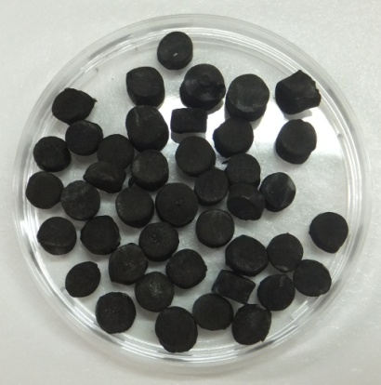
Impregnation of Cryogels with Silver Nanoparticles (NPs)
silver nitrate (AgNO₃)
sodium borohydride (NaBH₄)
PSA cryogels silver NP impregnated cryogels
Load PSA cryogels with aqueous solution of silver nitrate
R–COO– Na⁺ + Ag⁺ → R–COO– Ag⁺ + Na⁺
Reduce silver ions sorbed within the cryogels with sodium borohydride
R–COO– Ag⁺ + NaBH₄ + 3H₂O → R–COO– Na⁺ + Ag⁰ + H₂ + B(OH)₃

Slide 18
Characterization of Cryogel Morphology and Properties
2D structure via field-emission scanning electron microscopy (FESEM)
3D structure via reconstruction of 2D X-ray computer tomography (CT scan) images
Specific pore volume via gravimetric analysis of dry and wet (immersion in cyclohexane) samples
Stress-strain properties via computer-controlled Instron mechanical testing system

Slide 19
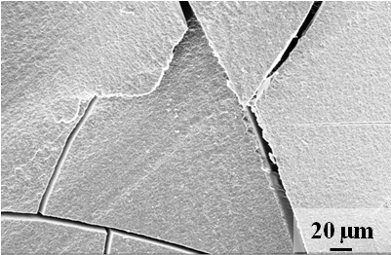
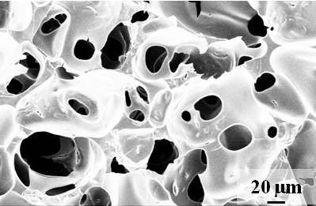
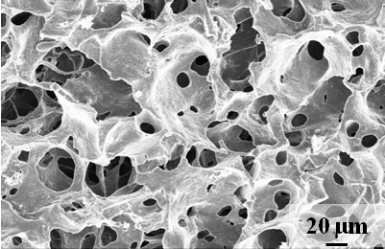
Results – Cryogel Morphology
Effect of preparation temperature
Decreasing preparation temperature
25 °C
-9 °C
-15 °C
Smaller mean pore size;
Narrower pore-size distribution;
Higher pore volume

Slide 20
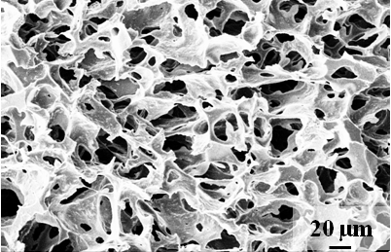
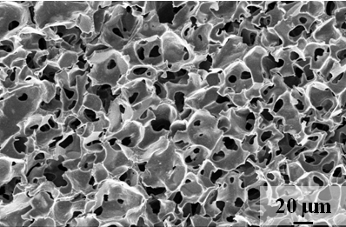
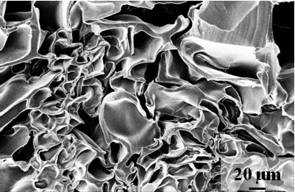
Results – Cryogel Morphology
Effect of initiator concentration
Increasing initiator concentration
1.75 mM
3.50 mM
7.00 mM
Freezing before gelation
Freezing after gelation
Well-interconnected open pores
Large closed pores

Slide 21
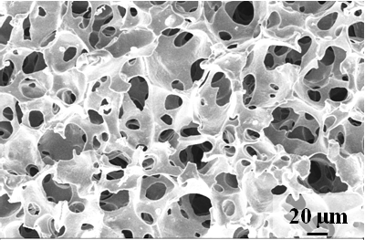
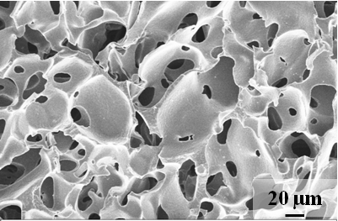
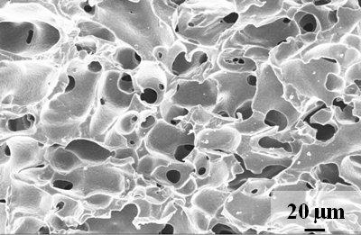
Results – Cryogel Morphology
Effect of monomer concentration
Increasing monomer concentration
8%
10%
15%
Larger mean pore size;
Reduced pore interconnectivity;
Reduced pore volume
Thicker pore walls

Slide 22
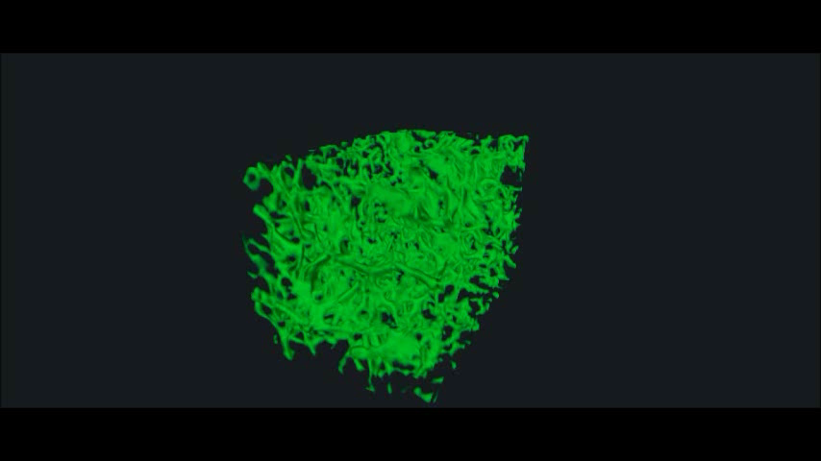
X-ray Microcomputed Tomographic 3D Reconstruction of Interconnected Porous Network of Synthesized PSA Cryogels

Slide 23
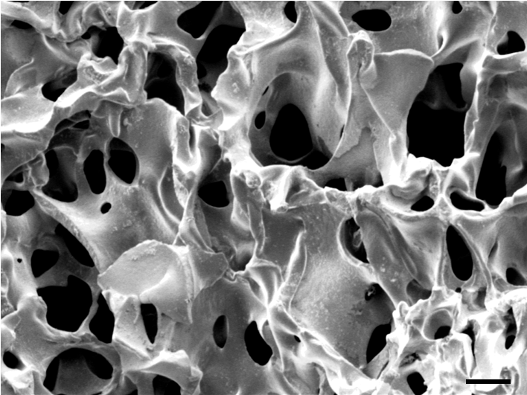
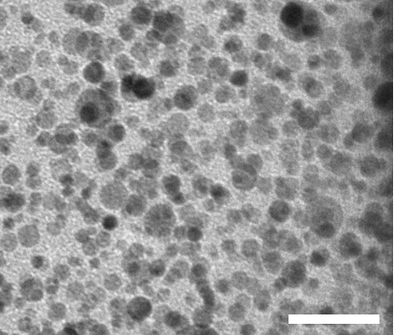
Silver NP Impregnated PSA Cryogel Morphology
Ag
50 nm
20 µm
20 nm
Highly interconnected porous network with good dispersion of the AgNPs on the pore walls of the PSA cryogels

Slide 24
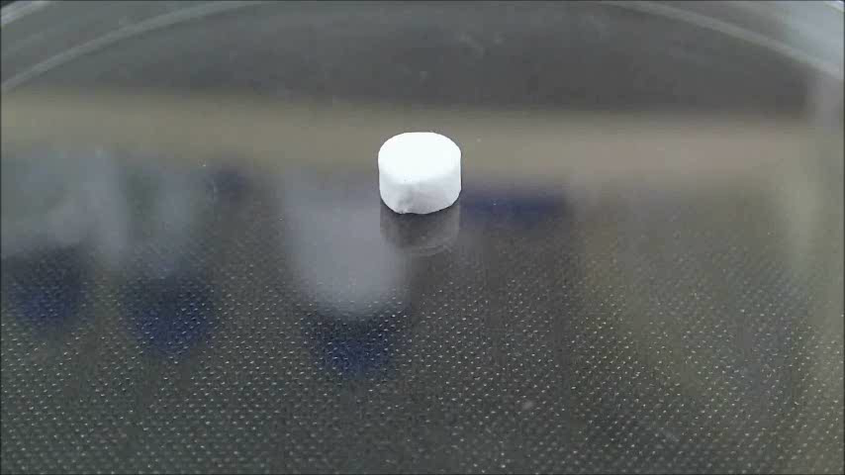
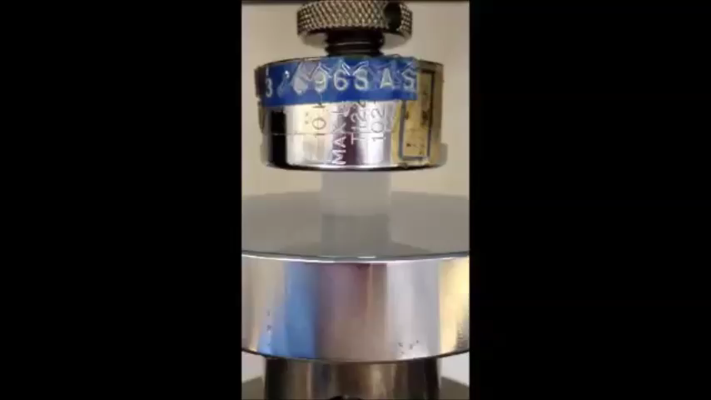
Water Sorption and Release
AgNC-X: X denotes the mg of silver per g of cryogel
t = 0 s
t = 2.27 s
t = 3.59 s
t = 6.30 s

Slide 25
Mechanical Properties
Mechanically robust
No change in degree of swelling owing to cyclic compression
No change in strain after 1000 compression/swelling cycles

Slide 26
Characterization of Bacteriological Pathogen Reduction
Efficacy tested against gram-negative Escherichia coli and Salmonella typhimurium and gram-positive Bacillus subtilis and Staphylococcus aureus
Live cell quantification via spread-plate method
Cell membrane integrity via FESEM, epifluorescence microscopy, and flow-cytometric analysis
Lipid (cell wall) peroxidation via thiobarbituric acid reactive substances (TBARS) assay
Leakage of cell cytoplasmic contents via UV spectrophotometry
Cellular adenosine triphosphate (ATP) level via luminescence luciferin/luciferase assay

Slide 27
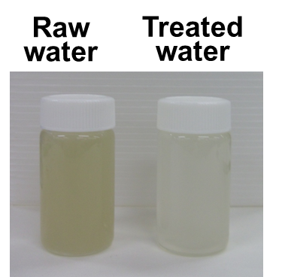
Turbidity Reduction

Slide 28
Bacteriological Pathogen Reduction
WHO limit
AgNC-X: X denotes the mg of silver per g of cryogel

Slide 29
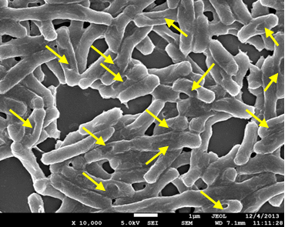
Bacterical Effect of PSA AgNPs
Arrows point to cell lesions (scale bar is 1 μm)

Slide 30
Biocidal Mechanism
Water absorption draws bacteria into porous cryogels causing contact with AgNPs on surface of pores
H⁺-rich environment around bacterial cells triggers release of Ag as Ag⁺
Ag⁺ is taken up by cells and inhibits ATP synthesis and the electron transport chain
This results in formation of ROS (H₂O₂ ) in the cell that diffuses out through the cell wall
H₂O₂ interacts with AgNPs to form –OH
–OH initiates peroxidative sequence that causes cell wall lesions, release of cytoplasm, and death of the bacteria

Slide 31
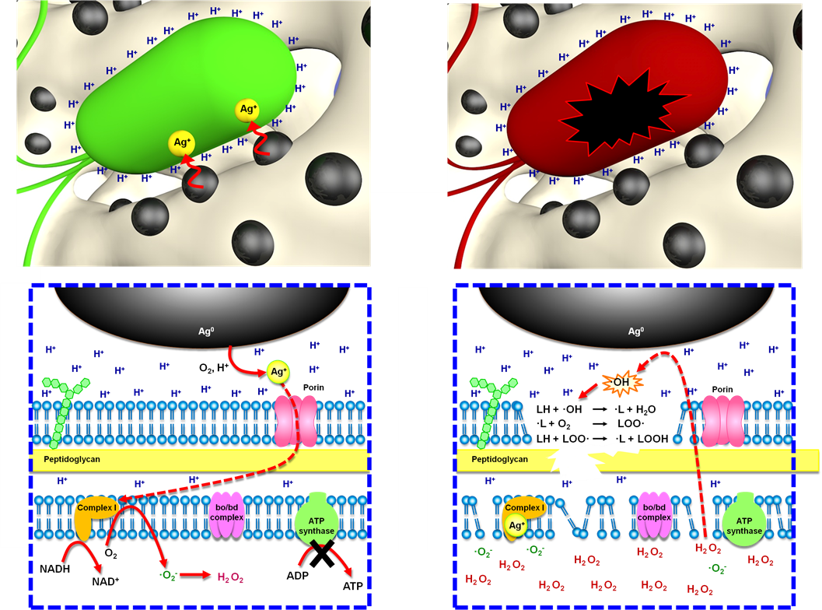
Schematic of Biocidal Mechanism

Slide 32
Summary of Cryogel Fabrication
Silver nanoparticle (AgNP) impregnated poly(sodium acrylate) cryogels can absorb water up to nearly 200 times their dry weight.
The AgNP cryogels can reach their equilibrium absorption capacity with 7 seconds.
The AgNP cryogels can release 85% of their sorbed water via compression by a hand-operated device.
The AgNP cryogels show no degradation over 1000 cycles of water sorption and compression.
The AgNP cryogels reduce turbidity below detectable levels.
The AgNP cryogels result in a six-log reduction in bacteriological pathogens.
The challenge now is to ‘Think Outside the Box’ to facilitate scale-up and deployment!

Slide 33
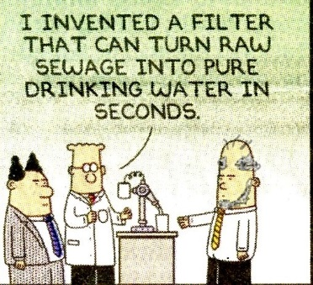
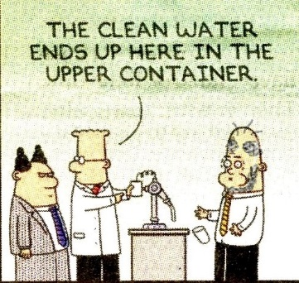
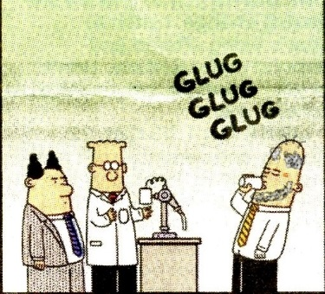
Water
Food
Food for Thought!
Tony Fane
Bill Krantz

Slide 34
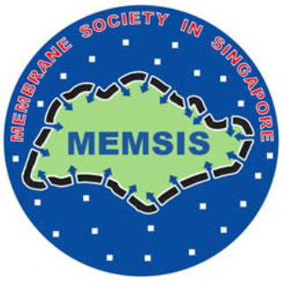

Acknowledgments
My student and faculty collaborators at the Singapore Membrane Technology Center (SMTC)
Professors Wang Rong, Director, and Tony Fane, Director Mentor, of SMTC, for their encouragement and support
The Singapore National Research Foundation and Public Utilities Board for their support of the SMTC
34

Slide 35
Thank You!
Questions?
krantz@colorado.edu

